Slide 1
Estimating suspended particulate matter using Google Earth Engine
Rudy Schueder

Slide 2
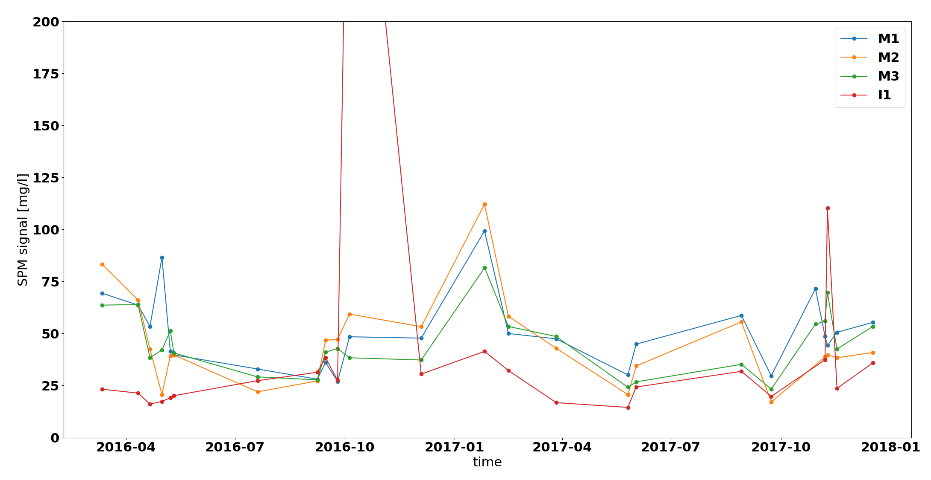
Ambition
Goal: To explore the potential of GEE for your remote sensing applications in water quality
Outcome: To plot time series of remotely sensed suspended particulate matter (SPM) for a location of your choosing (start thinking now!)
Laguna Lake, The Philippines

Slide 3
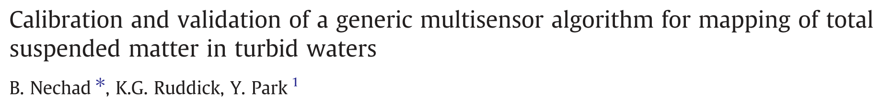
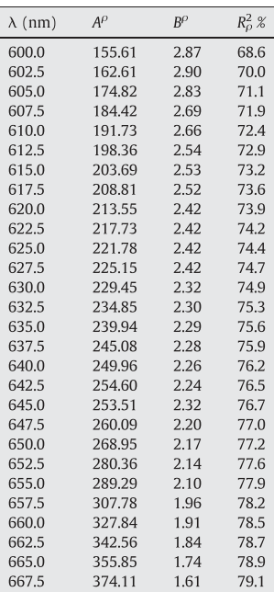
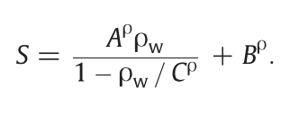
Methods
Table 4
empirical
empirical
SPM concentration
empirical
Water-leaving reflectance

Slide 4
Limitations
Method is intended to be a generalized method calibrated on Southern North Sea sediments
Method is only valid over water and in turbid systems
When we use Sentinel 2 data, we will use top of atmosphere reflectance to simplify things. Thus we ignore the critically important atmospheric correction.
Thus, this is an indicative exercise only!
Atmospheric correction packages are available for GEE but are not trivial to employ

Slide 5
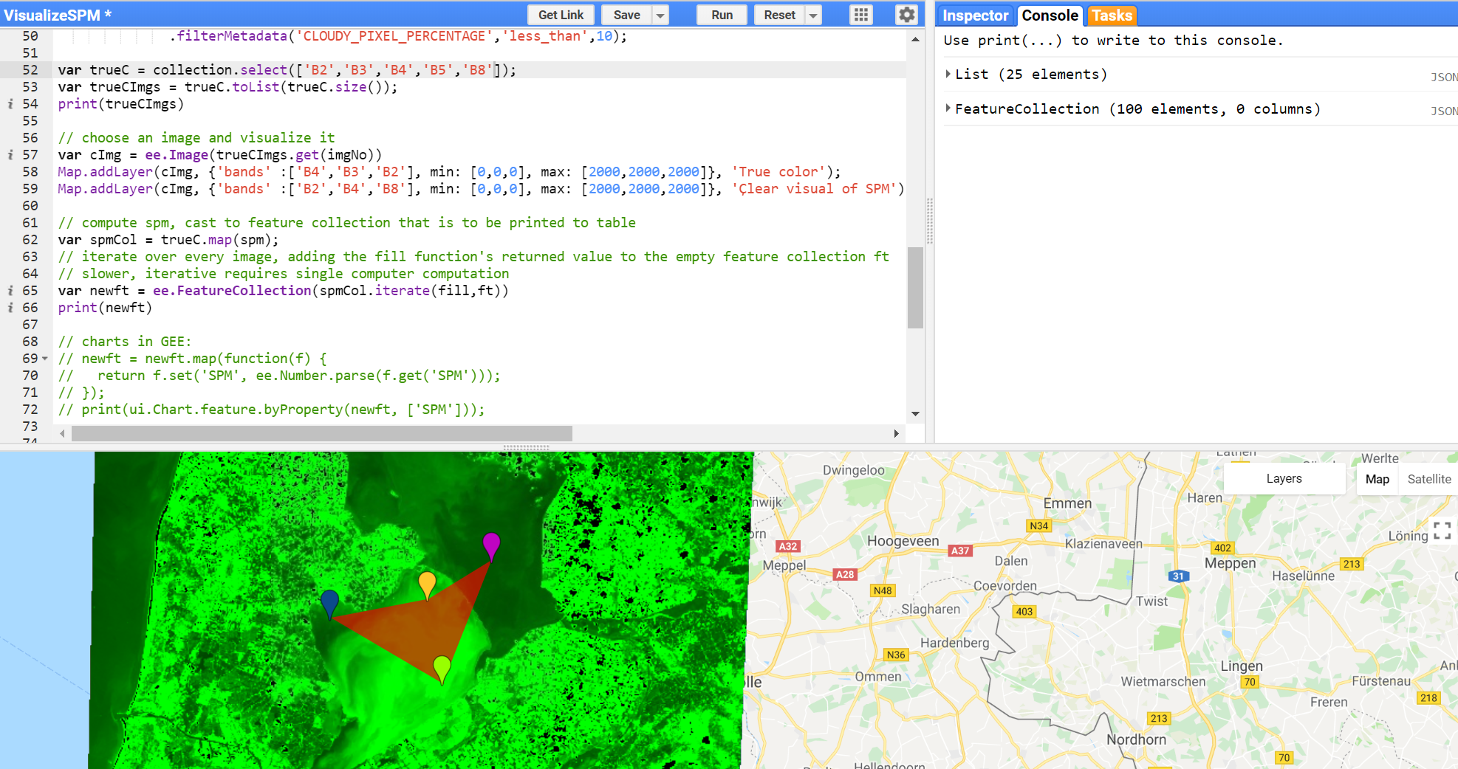
Let’s begin!

Slide 6
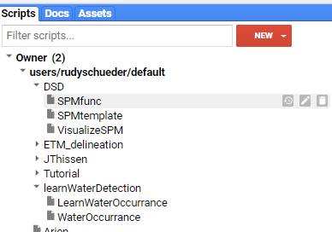
1. Get assets from GitHub
Go to
https://github.com/charlois/GEEDSD
Download all files to your computer
Go to https://code.earthengine.google.com/
Make a new file called ‘VisualizeSPM’
Copy contents of SPMtemplate.js to ‘VisualizeSPM’

Slide 7
2. Apply functions
Copy the ‘SPMfunc’ to VisualizeSPM. Look for the following heading

Slide 8
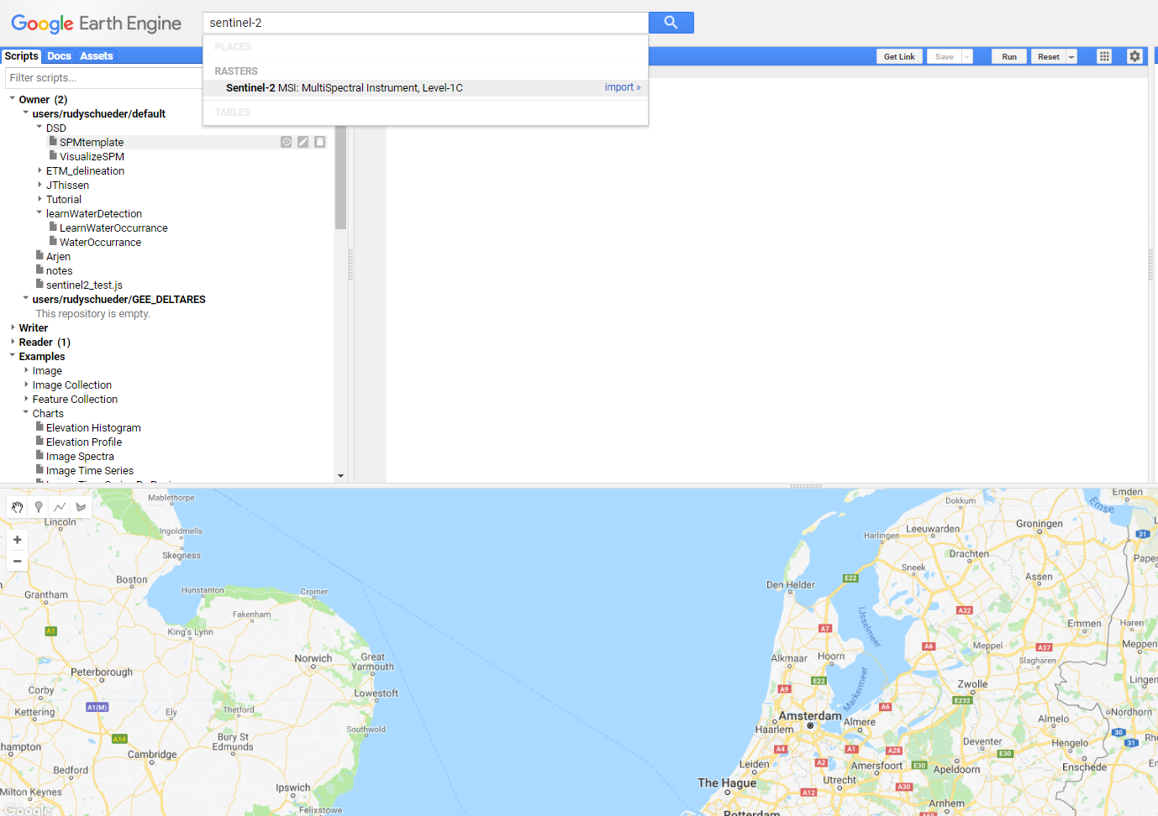
3. Import data

Slide 9
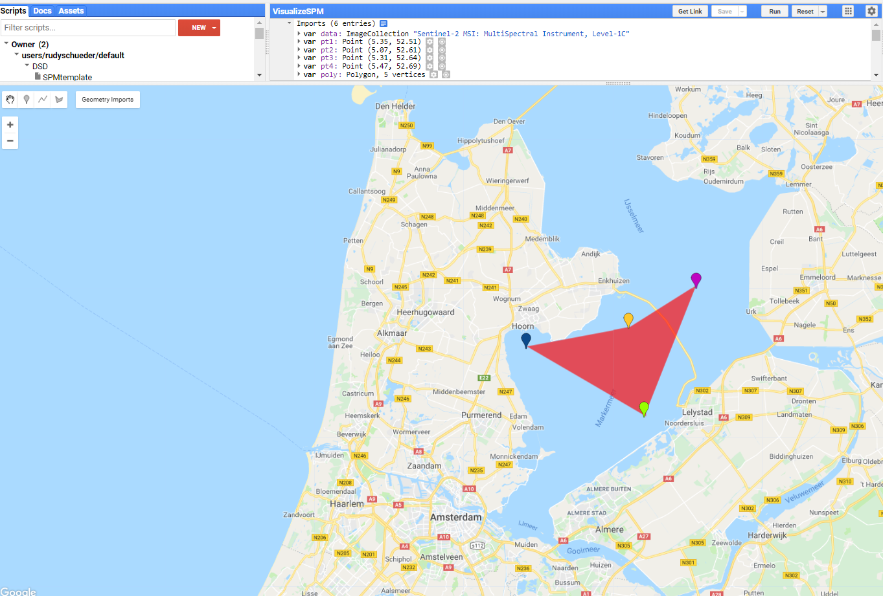
4. Choose some points of interest

Slide 10
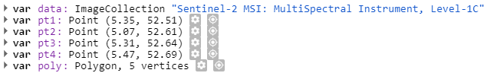
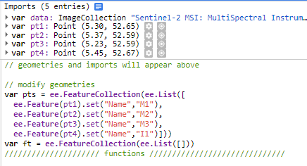
5. Rename, and put into a feature collection

Slide 11
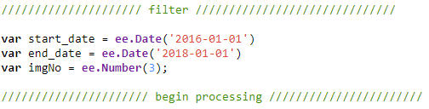
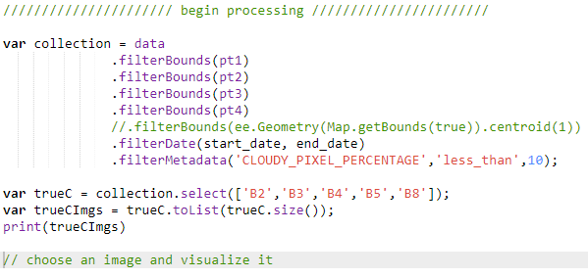
6. Select filter variables and filter, print result

Slide 12
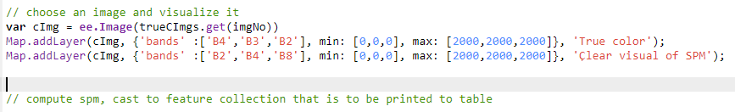
7. Visualize a single image (specified by imgNo)

Slide 13
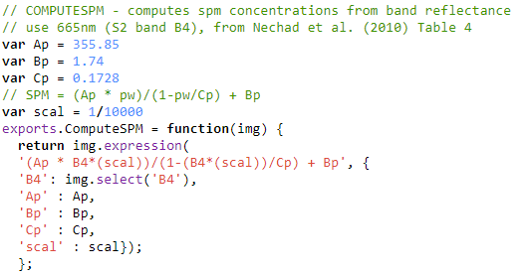
8. Compute the SPM
Resides in SPMfunc

Slide 14
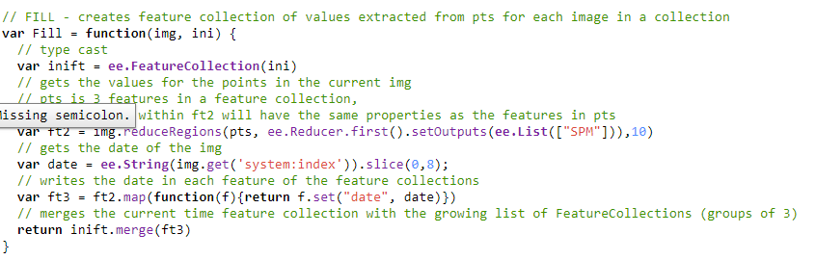
9. Extract the SPM from all points in each image

Slide 15
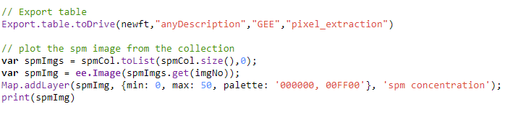
10. Export the table & visualize you SPM image

Slide 16
11. Plot in excel
Run the task and look for the .csv file in your google drive and plot (or use the python script on GitHub)

Slide 17
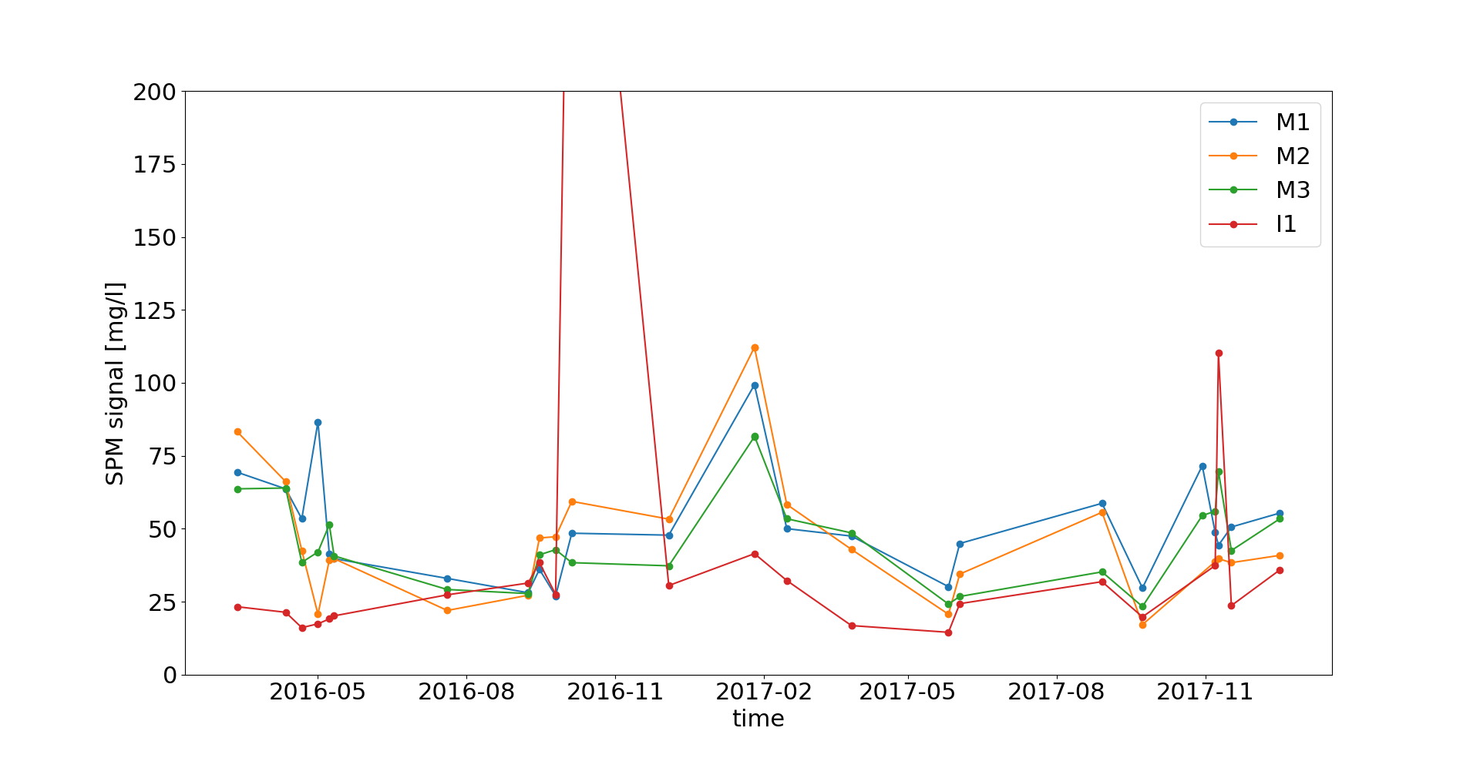
Result!

Slide 18
Extra

Slide 19
Why SPM?
Topic evident in this morning’s presentations
Plays an important role in ecological functioning
Strongly determines underwater light environment
Vector for contaminant transport (micro-organic pollutants, heavy metals)
Essential: Interacts with electromagnetic radiation

Slide 20
Why GEE?
Process satellite images “in the cloud”
Allows us to access multiple satellites using one set of tools
Allows us to easily look anywhere in the world, which is nice for our international gathering today

